Slide 1
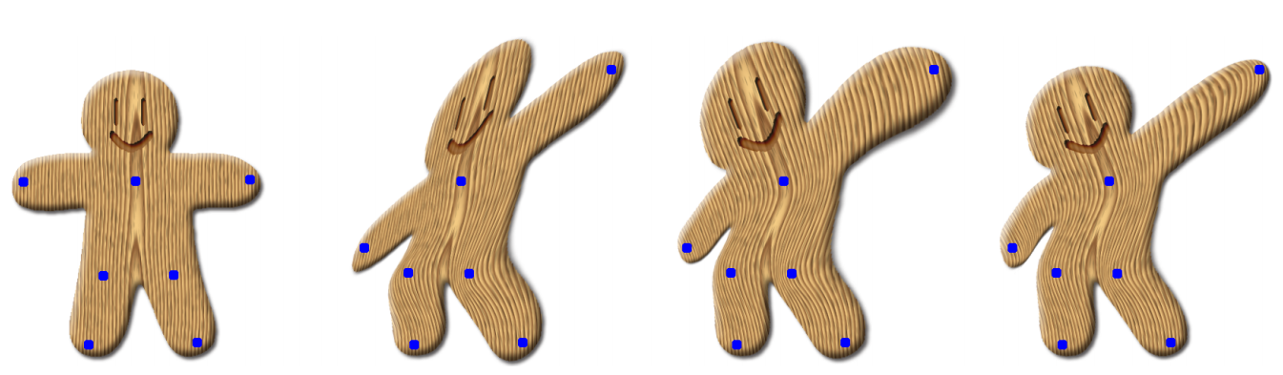
Global and Local Image Warping
Jun-Yan Zhu 16-726 Learning-based Image Synthesis, Spring 2021
© Schaefer et al., SIGGRAPH 2006

Slide 2
Image Transformations
image filtering: change range of image
g(x) = T(f(x))
f
f
T
x
x
image warping: change domain of image
g(x) = f(T(x))
f
f
T
x
x
Many slides are adopted from Alyosha Efros and Steve Seitz, among other great people.
See book chapter (Szeliski Sec 2.1.2)

Slide 3
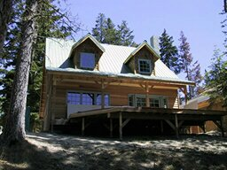
Image Transformations
image filtering: change range of image
g(x) = T(f(x))
f
g
T
image warping: change domain of image
g(x) = f(T(x))
f
g
T

Slide 4
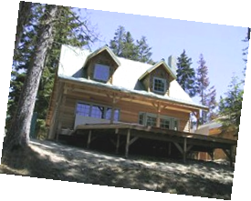
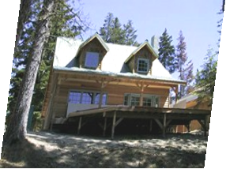
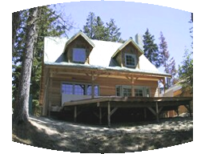
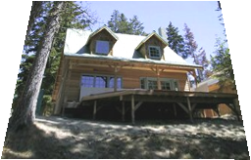
Parametric (global) warping
Examples of parametric warps:
translation
rotation
aspect
perspective
affine
cylindrical

Slide 5
Parametric (global) warping
T
p = (x,y)
p’ = (x’,y’)
Transformation T is a coordinate-changing machine:
p’ = T(p)
What does it mean that T is global?
Is the same for any point p
can be described by just a few numbers (parameters)
Let’s represent a linear T as a matrix:
p’ = Mp

Slide 6
Scaling
Scaling a coordinate means multiplying each of its components by a scalar
Uniform scaling means this scalar is the same for all components:
× 2

Slide 7
Scaling
Non-uniform scaling: different scalars per component:
X × 2, Y × 0.5

Slide 8
Scaling
Scaling operation:
Or, in matrix form:
scaling matrix S
What’s inverse of S?

Slide 9
2-D Rotation
(x’, y’)
(x, y)
x’ = x cos(θ) - y sin(θ)
y’ = x sin(θ) + y cos(θ)
θ

Slide 10
2-D Rotation
x = r cos (φ)
y = r sin (φ)
x’ = r cos (φ + θ)
y’ = r sin (φ + θ)
(x’, y’)
(x, y)
θ
φ

Slide 11
2-D Rotation
x = r cos (φ)
y = r sin (φ)
x’ = r cos (φ + θ)
y’ = r sin (φ + θ)
Trig Identity…
x’ = r cos(φ) cos(θ) – r sin(φ) sin(θ)
y’ = r sin(φ) cos(θ) + r cos(φ) sin(θ)
(x’, y’)
(x, y)
θ
φ

Slide 12
2-D Rotation
x = r cos (φ)
y = r sin (φ)
x’ = r cos (φ + θ)
y’ = r sin (φ + θ)
Trig Identity…
x’ = r cos(φ) cos(θ) – r sin(φ) sin(θ)
y’ = r sin(φ) cos(θ) + r cos(φ) sin(θ)
Substitute…
x’ = x cos(θ) - y sin(θ)
y’ = x sin(θ) + y cos(θ)
(x’, y’)
(x, y)
θ
φ

Slide 13
2-D Rotation
This is easy to capture in matrix form:
Even though sin(θ) and cos(θ) are nonlinear functions of θ,
x’ is a linear combination of x and y
y’ is a linear combination of x and y
What is the inverse transformation?
Rotation by –θ
For rotation matrices
R

Slide 14
2x2 Matrices
What types of transformations can be represented with a 2x2 matrix?
2D Identity?
2D Scale around (0,0)?

Slide 15
2x2 Matrices
What types of transformations can be represented with a 2x2 matrix?
2D Rotate around (0,0)?
2D Shear?

Slide 16
2x2 Matrices
What types of transformations can be represented with a 2x2 matrix?
2D Mirror about Y axis?
2D Mirror over (0,0)?

Slide 17
2x2 Matrices
What types of transformations can be represented with a 2x2 matrix?
2D Translation?
NO!
Only linear 2D transformations
can be represented with a 2x2 matrix

Slide 18
All 2D Linear Transformations
Linear transformations are combinations of …
Scale,
Rotation,
Shear, and
Mirror
Properties of linear transformations:
Origin maps to origin
Lines map to lines
Parallel lines remain parallel
Ratios are preserved
Closed under composition

Slide 19
Consider a different Basis
j =(0,1)
v =(v_{x},v_{y})
p
q
u=(u_{x},u_{y})
i =(1,0)
q=4i+3j = (4,3)
p=4u+3v

Slide 20
Linear Transformations as Change of Basis
v =(v_{x},v_{y})
j =(0,1)
p^{uv}
p^{ij}
u=(u_{x},u_{y})
i =(1,0)
p^{uv} = (4,3)
p^{ij} = 4u+3v
p_{x}=4u_{x}+3v_{x}
p_{y}=4u_{y}+3v_{y}
⎡
u
v
⎤
⎡
4
⎤
⎡
u
v
⎤
p^{ij}
=
⎢
x
x
⎥
=
⎢
x
x
⎥
p^{uv}
⎢
⎥
⎣
u
v
⎦
⎣
3
⎦
⎣
u
v
⎦
y
y
y
y
Any linear transformation is a basis!!!

Slide 21
What’s the inverse transform?
j =(0,1)
v =(v_{x},v_{y})
p^{ij}
p^{uv}
u=(u_{x},u_{y})
i =(1,0)
p^{ij} = (5,4)
= p_{x}u + p_{y}v
p^{uv} = (p_{x},p_{y}) = ?
-1
-1
⎡
u
v
⎤
⎡
5
⎤
⎡
u
v
⎤
p^{uv}
=
⎢
x
x
⎥
=
⎢
x
x
⎥
p^{ij}
⎢
⎥
⎣
u
v
⎦
⎣
4
⎦
⎣
u
v
⎦
y
y
y
y
How can we change from any basis to any basis?
What if the basis are orthogonal?

Slide 22
Projection onto orthogonal basis
j =(0,1)
v =(v_{x},v_{y})
p^{ij}
p^{uv}
u=(u_{x},u_{y})
i =(1,0)
p^{ij} = (5,4)
p^{uv} = (u·p^{ij}, v·p^{ij})
⎡
u
u
⎤
⎡
5
⎤
⎡
u
u
⎤
p^{uv}
=
⎢
x
x
⎥
=
⎢
x
y
⎥
p^{ij}
⎢
⎥
⎣
v
v
⎦
⎣
4
⎦
⎣
v
v
⎦
y
y
x
y

Slide 23
Homogeneous Coordinates
Q: How can we represent translation as a 3x3 matrix?

Slide 24
Homogeneous Coordinates
Homogeneous coordinates
represent coordinates in 2 dimensions with a 3-vector

Slide 25
Homogeneous Coordinates
Add a 3rd coordinate to every 2D point
(x, y, w) represents a point at location (x/w, y/w)
(x, y, 0) represents a point at infinity
(0, 0, 0) is not allowed
y
2
(2,1,1)
or (4,2,2)
or (6,3,3)
1
Convenient coordinate system to represent many useful transformations
x
1
2

Slide 26
Homogeneous Coordinates
Q: How can we represent translation as a 3x3 matrix?
A: Using the rightmost column:

Slide 27
Translation
Example of translation
Homogeneous Coordinates
t_{x} = 2 t_{y} = 1

Slide 28
Basic 2D Transformations
Basic 2D transformations as 3x3 matrices
Translate
Scale
Rotate
Shear

Slide 29
Matrix Composition
Transformations can be combined by matrix multiplication
p’ = T(t_{x},t_{y}) R(Θ) S(s_{x},s_{y}) p
Does the order of multiplication matter?

Slide 30
Affine Transformations
Affine transformations are combinations of …
Linear transformations, and
Translations
Properties of affine transformations:
Origin does not necessarily map to origin
Lines map to lines
Parallel lines remain parallel
Ratios are preserved
Closed under composition
Models change of basis
Will the last coordinate w always be 1?

Slide 31
Projective Transformations
Projective transformations …
Affine transformations, and
Projective warps
Properties of projective transformations:
Origin does not necessarily map to origin
Lines map to lines
Parallel lines do not necessarily remain parallel
Ratios are not preserved
Closed under composition
Models change of basis

Slide 32
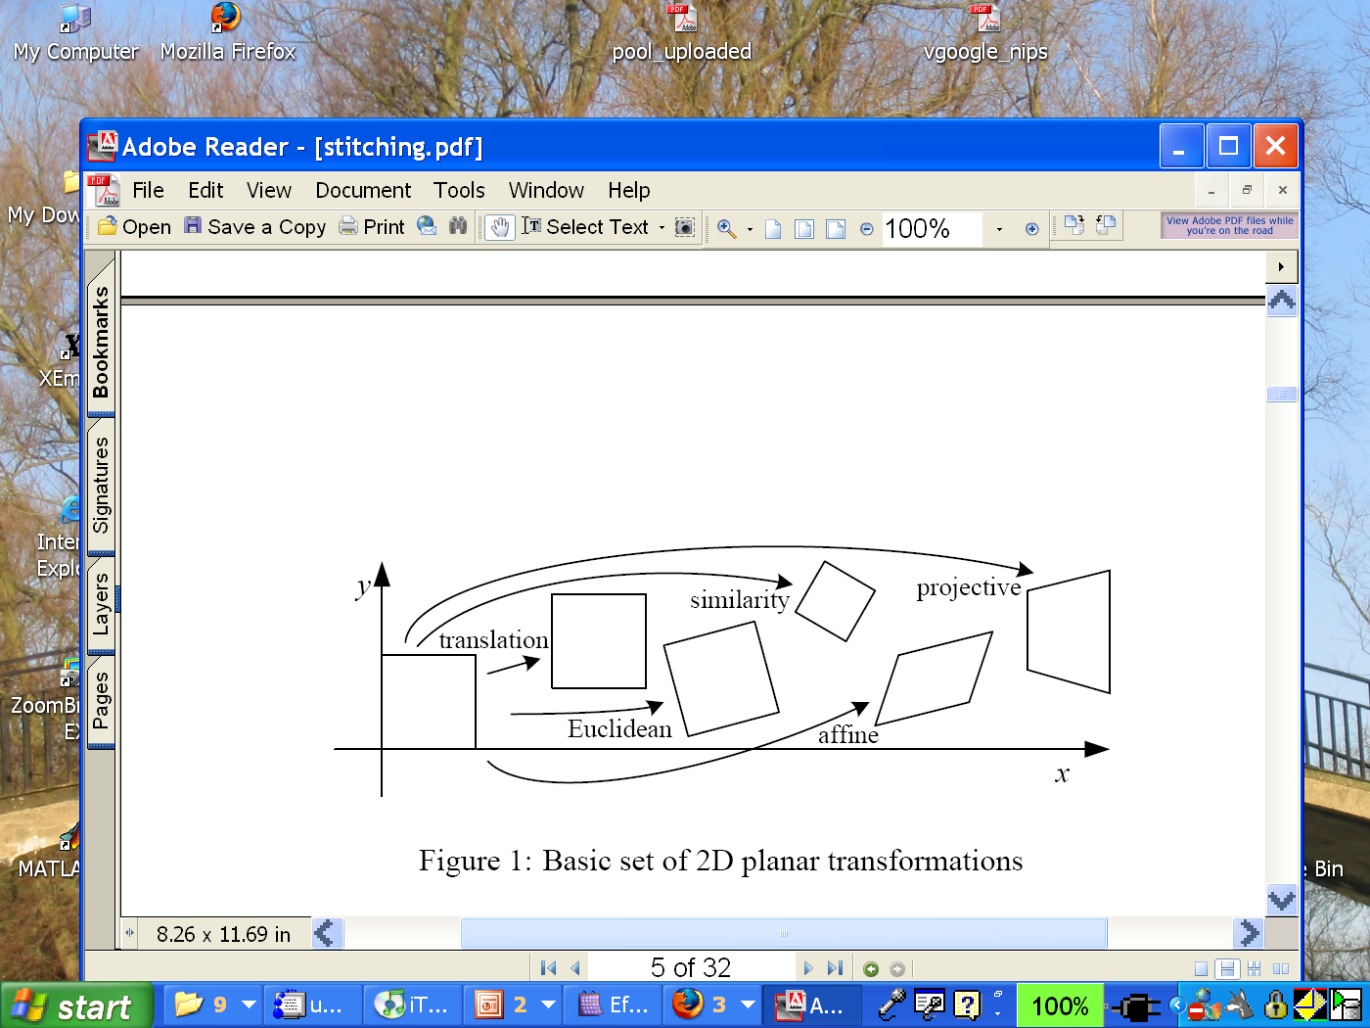
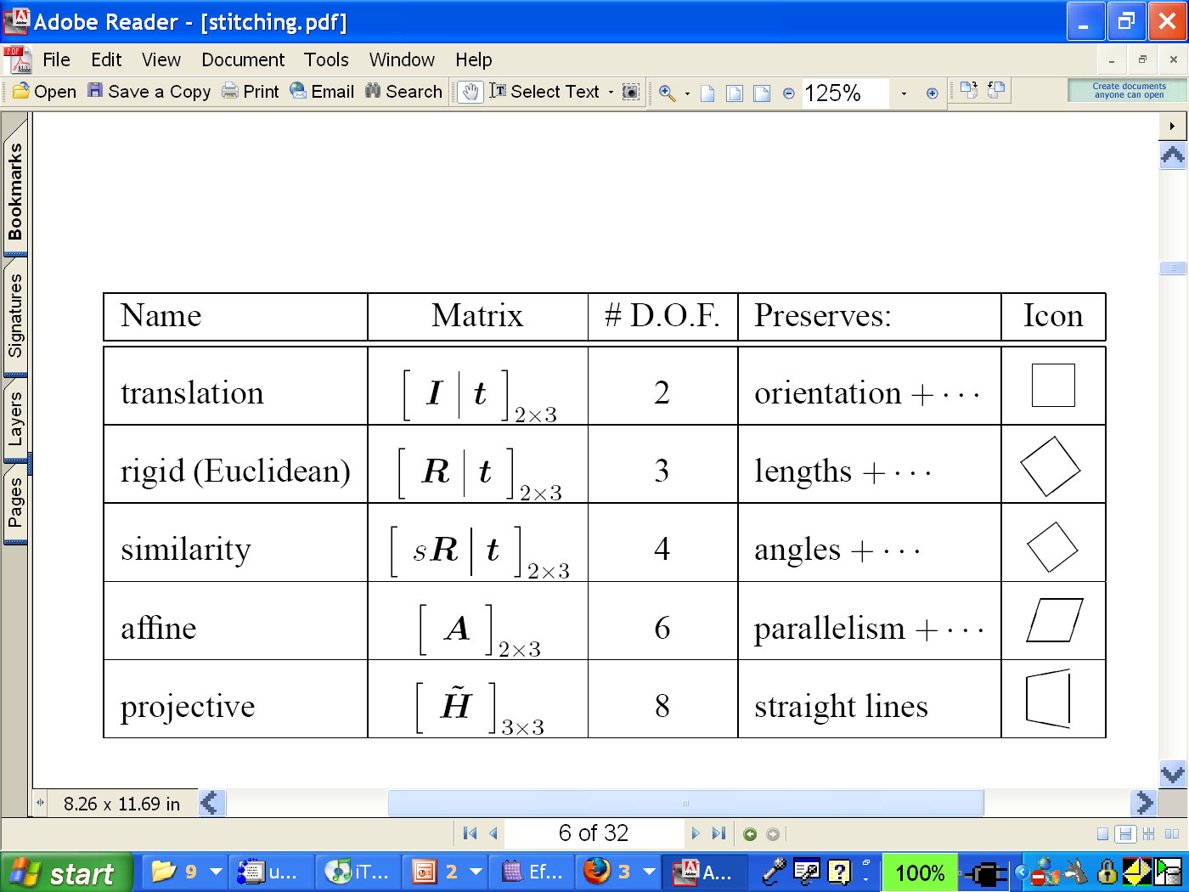
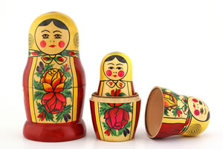
2D image transformations
These transformations are a nested set of groups
Closed under composition and inverse is a member
Notes:
Russian nesting doll

Slide 33
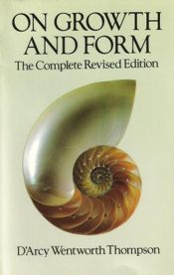
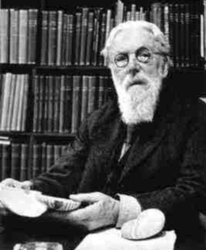
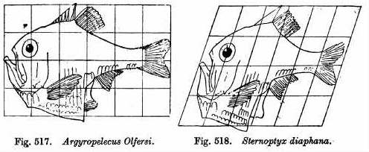
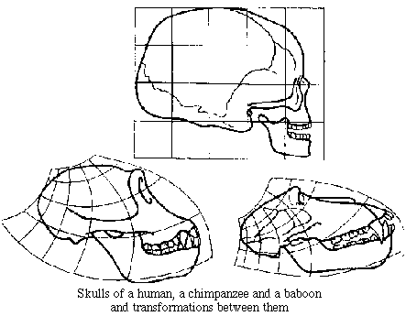
Image Warping in Biology
D'Arcy Thompson
http://www-groups.dcs.st-and.ac.uk/~history/Miscellaneous/darcy.html
http://en.wikipedia.org/wiki/D'Arcy_Thompson
Importance of shape and structure in evolution
Slide by Durand and Freeman
Notes:
Thompson explored the degree to which differences in the forms of related animals could be described by means of relatively simple mathematical transformations.

Slide 34
Recovering Transformations
?
T(x,y)
y
y’
x
x’
f(x,y)
g(x’,y’)
What if we know f and g and want to recover the transform T?
e.g. better align images from Project 1
willing to let user provide correspondences
How many do we need?

Slide 35
Translation: # correspondences?
?
T(x,y)
y
y’
x
x’
How many correspondences needed for translation?
How many Degrees of Freedom?
What is the transformation matrix?

Slide 36
Euclidian: # correspondences?
?
T(x,y)
y
y’
x
x’
How many correspondences needed for translation+rotation?
How many DOF?

Slide 37
Affine: # correspondences?
?
T(x,y)
y
y’
x
x’
How many correspondences needed for affine?
How many DOF?

Slide 38
Projective: # correspondences?
?
T(x,y)
y
y’
x
x’
How many correspondences needed for projective?
How many DOF?

Slide 39

Example: warping triangles
B
B’
?
T(x,y)
C’
A
C
A’
Source
Destination
Given two triangles: ABC and A’B’C’ in 2D (12 numbers)
Need to find transform T to transfer all pixels from one to the other.
What kind of transformation is T?
How can we compute the transformation matrix:
Two ways:
Algebraic and
geometric

Slide 40
warping triangles (Barycentric Coordinaes)
(0,1)
(0,0)
(1,0)
B
B’
Inverse
change
of basis
change
of basis
C’
A
C
A’
Source
Destination
Don’t forget to move the origin too!
Very useful for Project 4… (hint,hint,nudge,nudge)

Slide 41
Image warping
T(x,y)
y
y’
x
x’
f(x,y)
g(x’,y’)
Given a coordinate transform (x’,y’) = T(x,y) and a source image f(x,y), how do we compute a transformed image g(x’,y’) = f(T(x,y))?

Slide 42
Forward warping
T(x,y)
y
y’
x
x’
f(x,y)
g(x’,y’)
Send each pixel f(x,y) to its corresponding location
(x’,y’) = T(x,y) in the second image
Q: what if pixel lands “between” two pixels?

Slide 43
Forward warping
T(x,y)
y
y’
x
x’
f(x,y)
g(x’,y’)
Send each pixel f(x,y) to its corresponding location
(x’,y’) = T(x,y) in the second image
Q: what if pixel lands “between” two pixels?
A: distribute color among neighboring pixels (x’,y’)
Known as “splatting”
Check out griddata in Matlab

Slide 44
Inverse warping
T⁻¹(x,y)
y
y’
x
x
x’
f(x,y)
g(x’,y’)
Get each pixel g(x’,y’) from its corresponding location
(x,y) = T⁻¹(x’,y’) in the first image
Q: what if pixel comes from “between” two pixels?

Slide 45
Inverse warping
T⁻¹(x,y)
y
y’
x
x
x’
f(x,y)
g(x’,y’)
Get each pixel g(x’,y’) from its corresponding location
(x,y) = T⁻¹(x’,y’) in the first image
Q: what if pixel comes from “between” two pixels?
A: Interpolate color value from neighbors
nearest neighbor, bilinear, Gaussian, bicubic
Check out interp2 in Matlab

Slide 46
Forward vs. inverse warping
Q: which is better?
A: usually inverse—eliminates holes
however, it requires an invertible warp function—not always possible...

Slide 47
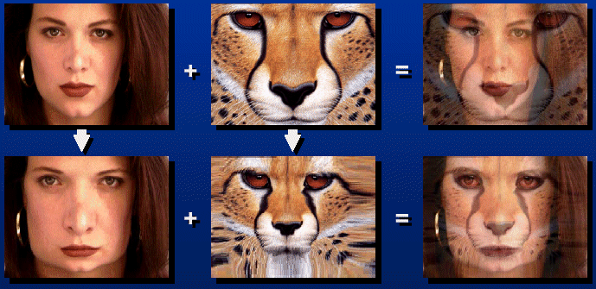

Morphing = Object Averaging
The aim is to find “an average” between two objects
Not an average of two images of objects…
…but an image of the average object!
How can we make a smooth transition in time?
Do a “weighted average” over time t
How do we know what the average object looks like?
We haven’t a clue!
But we can often fake something reasonable
Usually required user/artist input

Slide 48
Averaging Points
Q
What’s the average
of P and Q?
v = Q - P
P
P + 1.5v
= P + 1.5(Q – P)
= -0.5P + 1.5 Q
(extrapolation)
P + 0.5v
= P + 0.5(Q – P)
= 0.5P + 0.5 Q
Linear Interpolation
(Affine Combination):
New point aP + bQ,
defined only when a+b = 1
So aP+bQ = aP+(1-a)Q
P and Q can be anything:
points on a plane (2D) or in space (3D)
Colors in RGB or HSV (3D)
Whole images (m-by-n D)… etc.

Slide 49
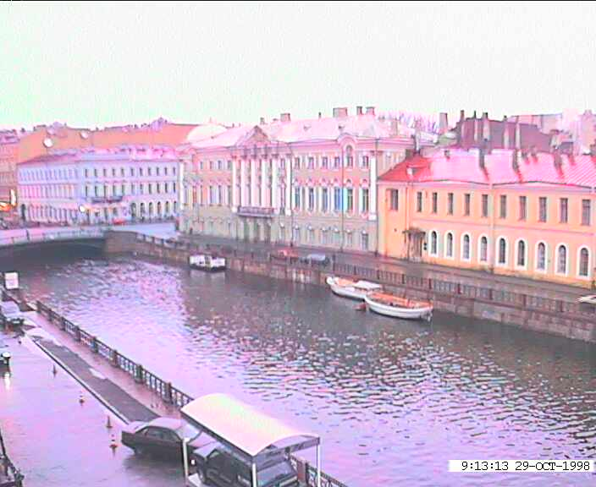
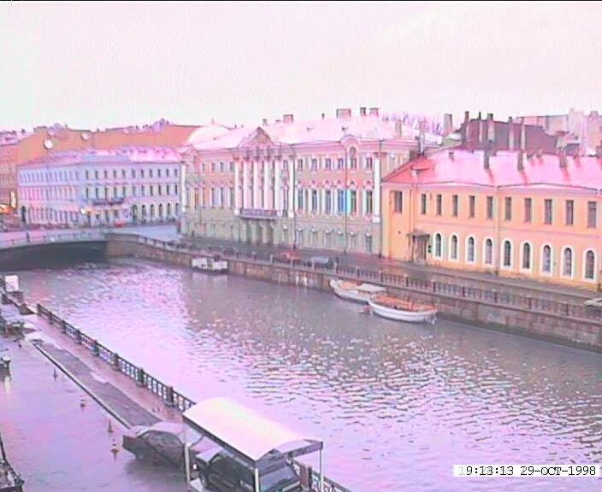
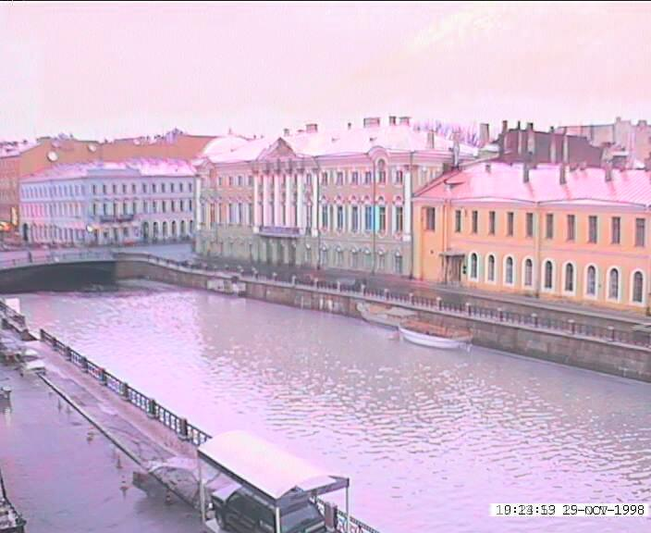
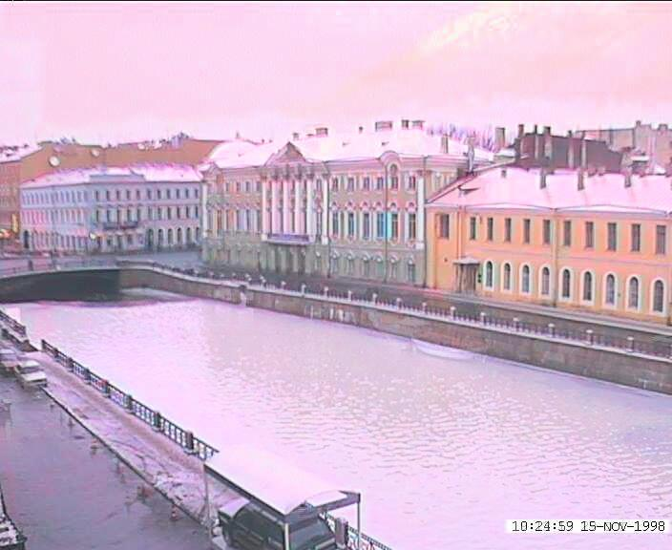
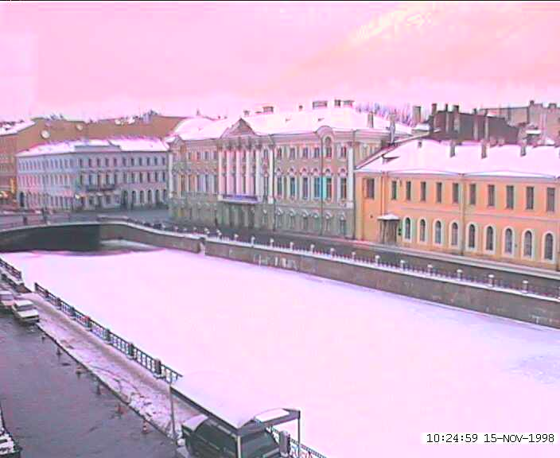
Idea #1: Cross-Dissolve
Interpolate whole images:
Image_{halfway} = (1-t)*Image₁ + t*image₂
This is called cross-dissolve in film industry
But what is the images are not aligned?

Slide 50
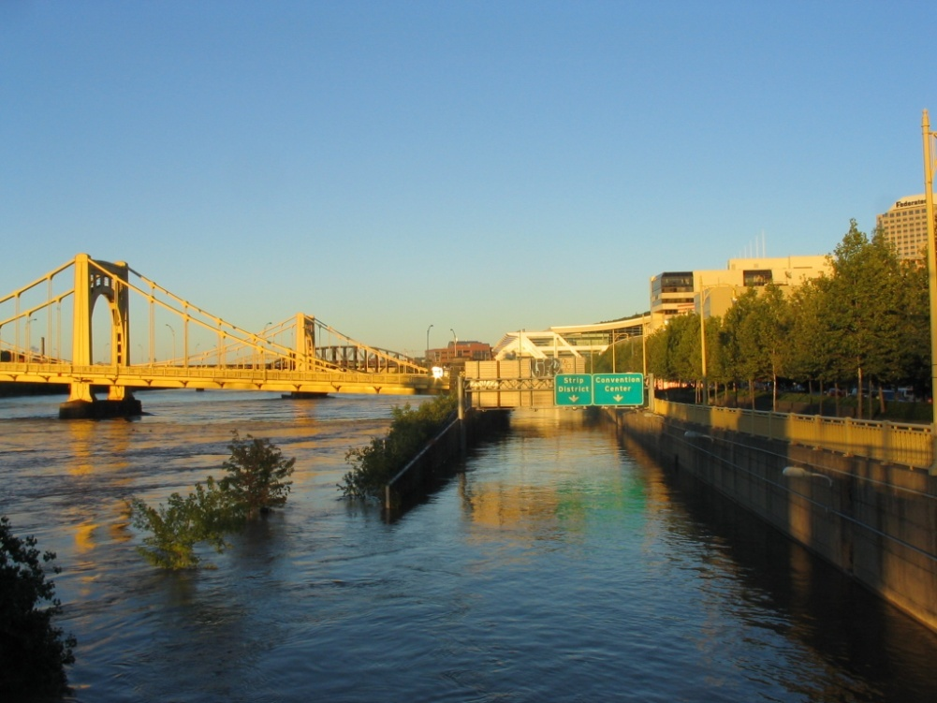
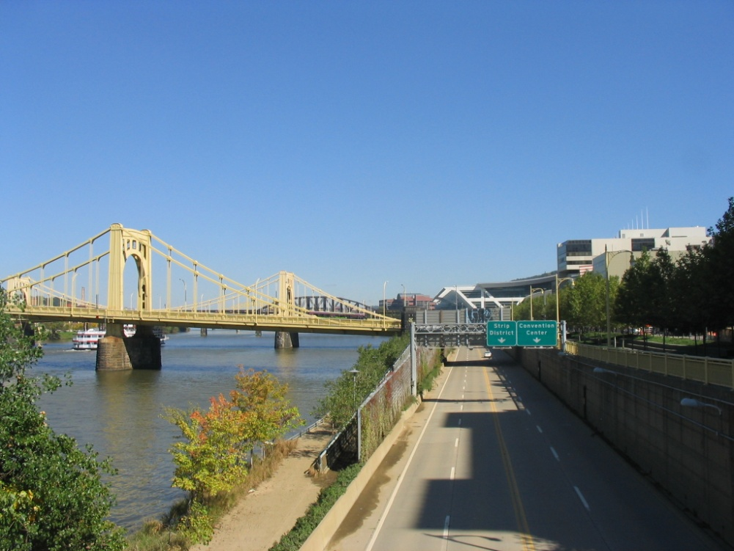
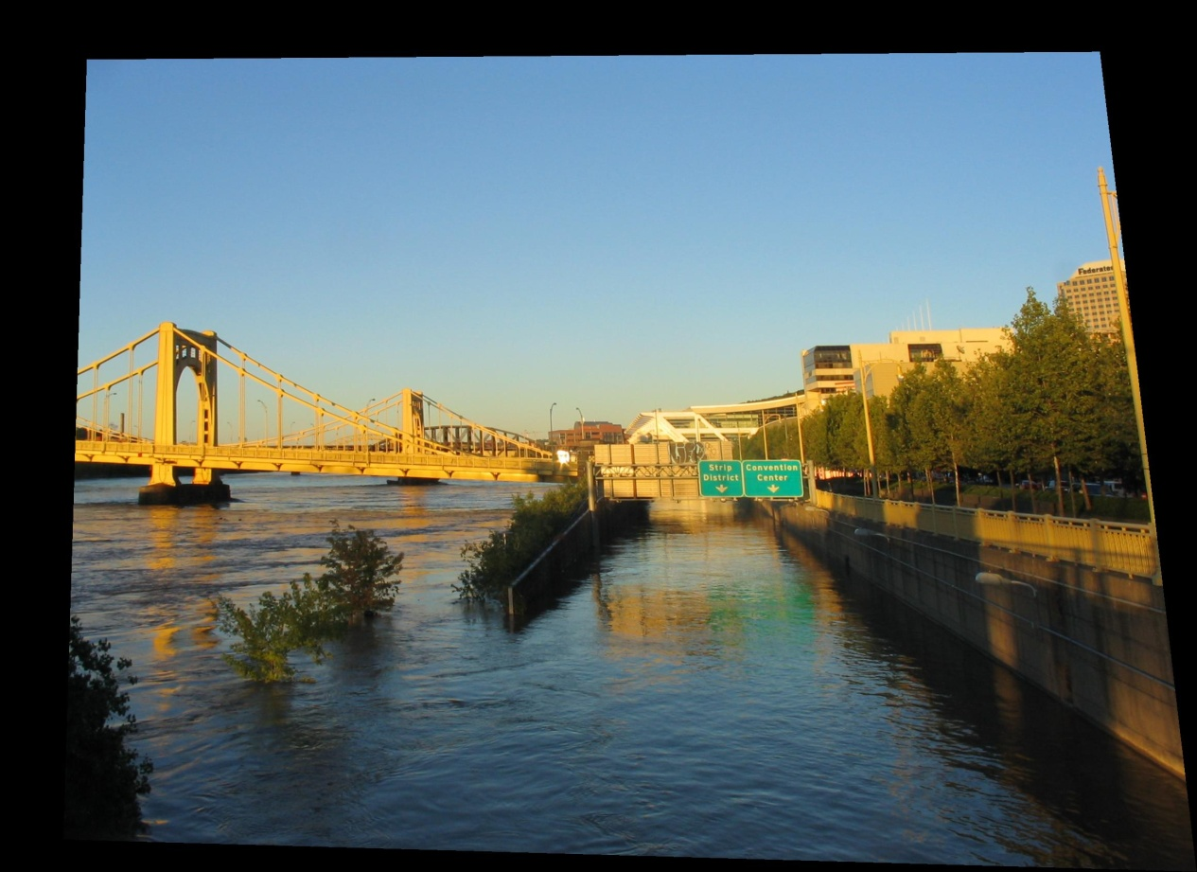
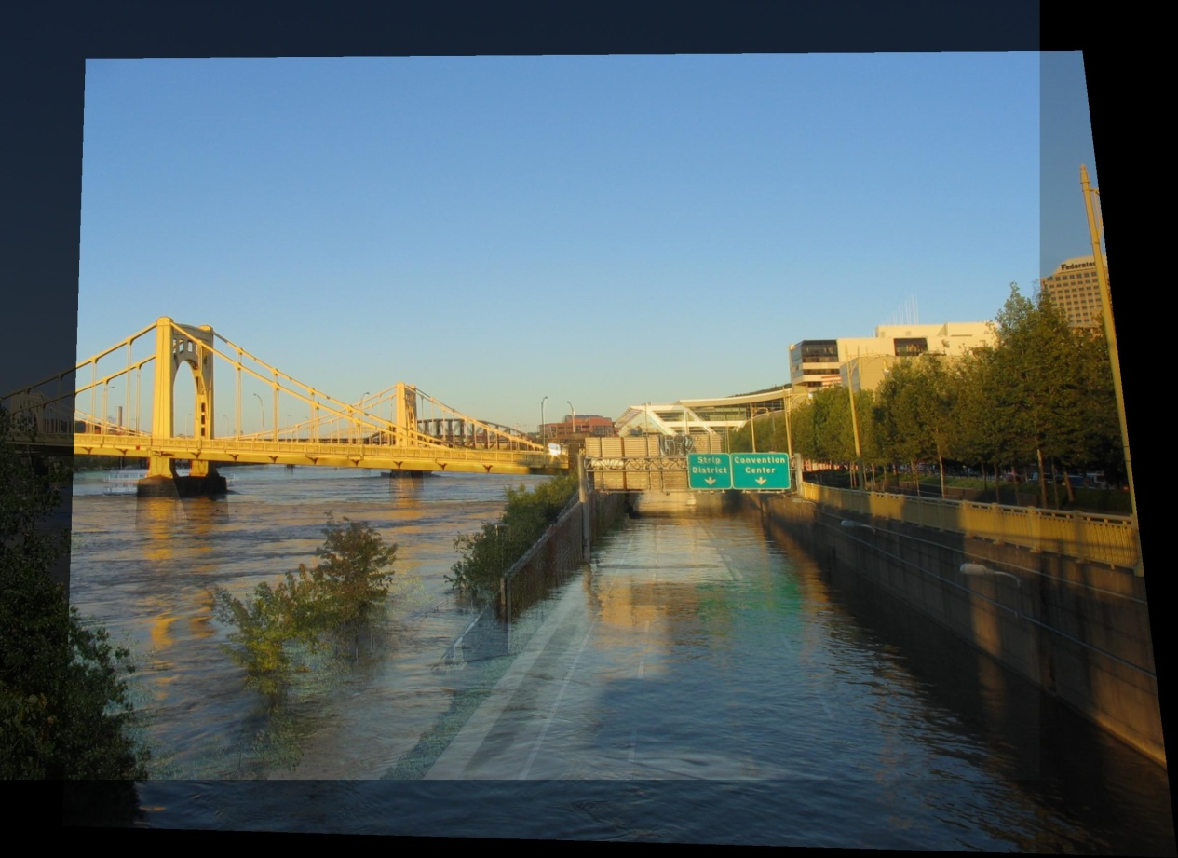
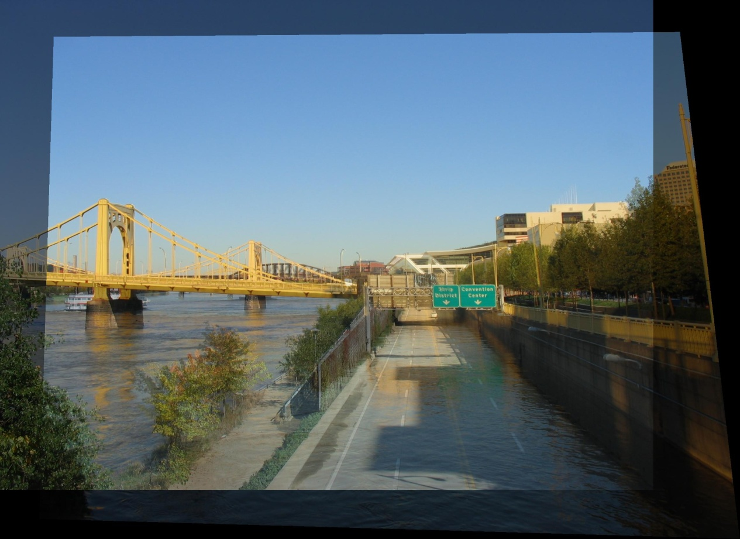
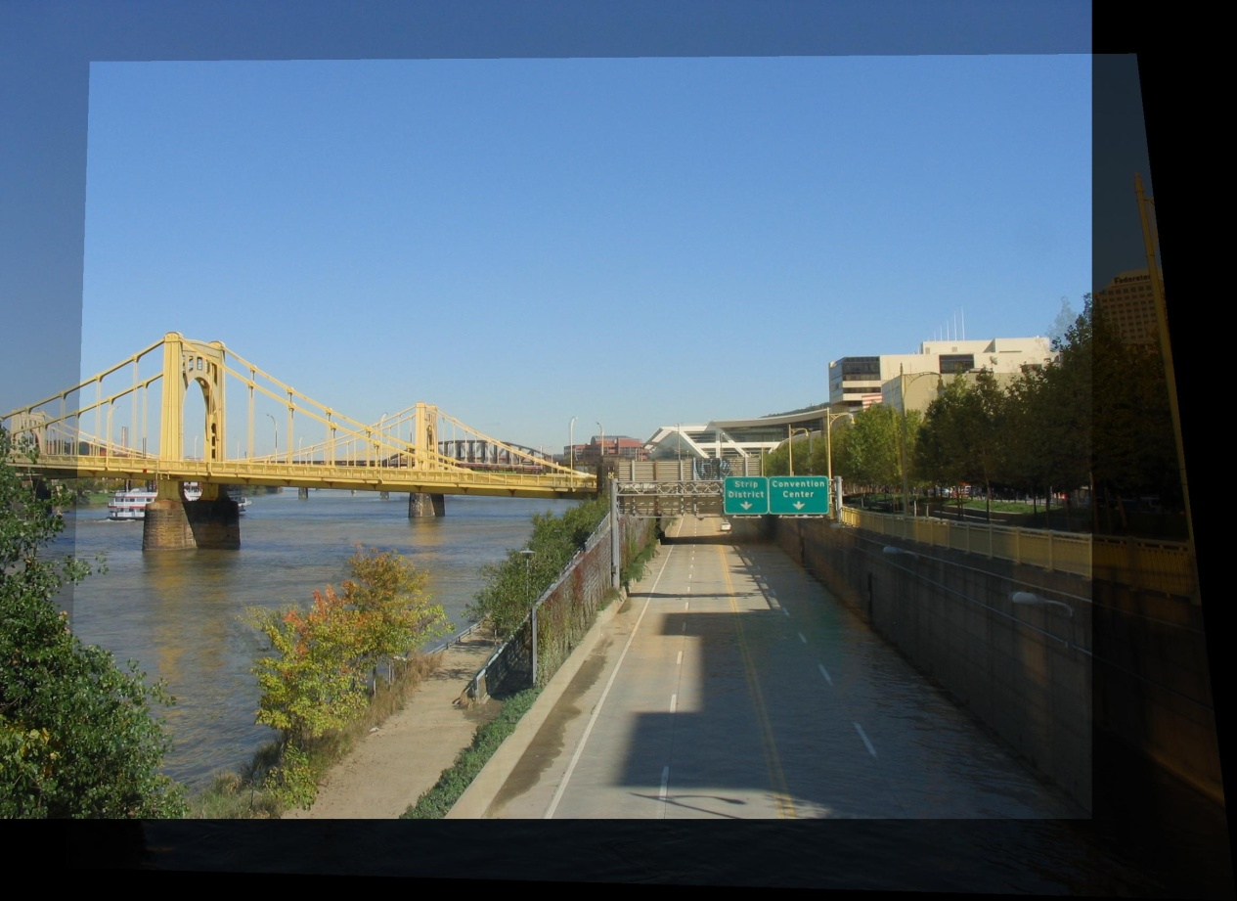
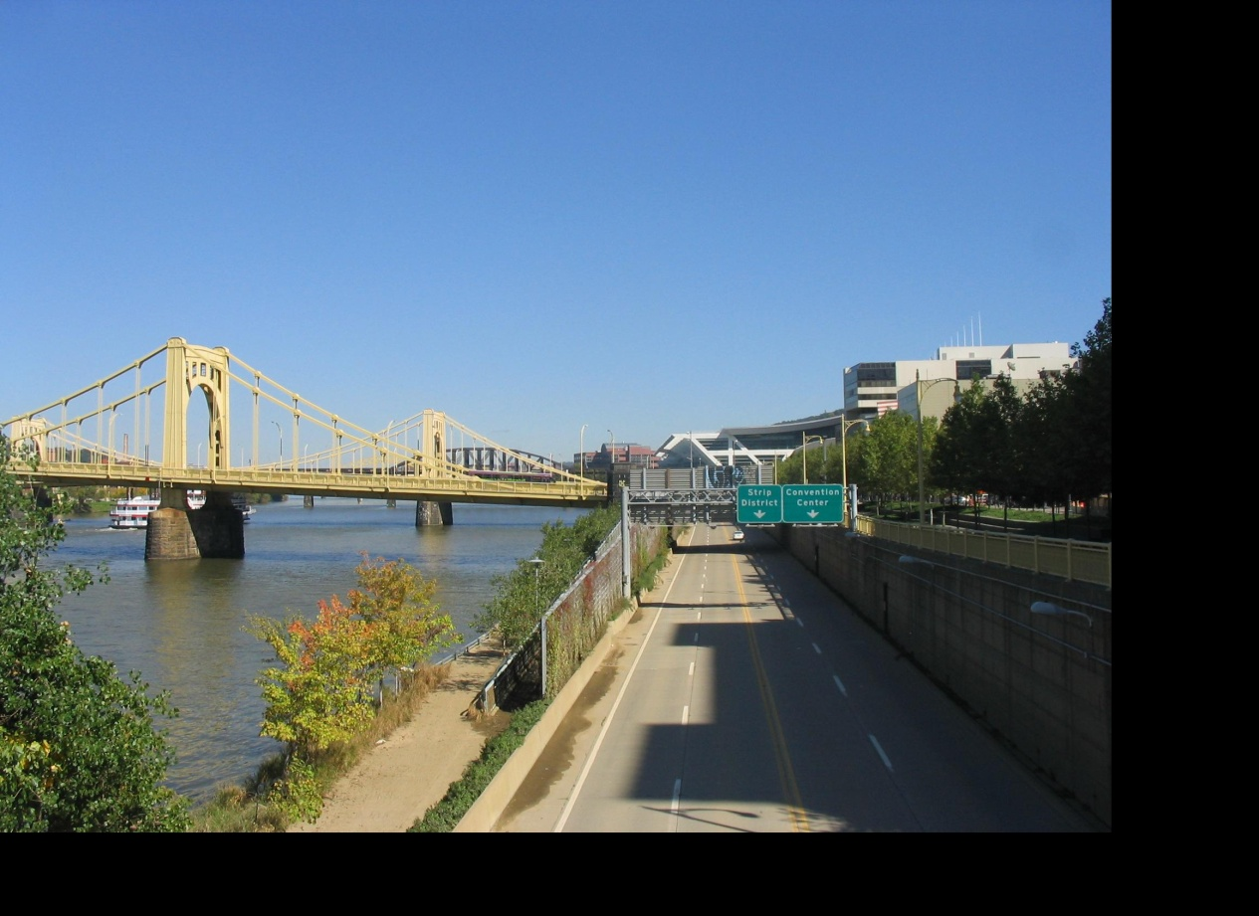
Idea #2: Align, then cross-disolve
Align first, then cross-dissolve
Alignment using global warp – picture still valid

Slide 51
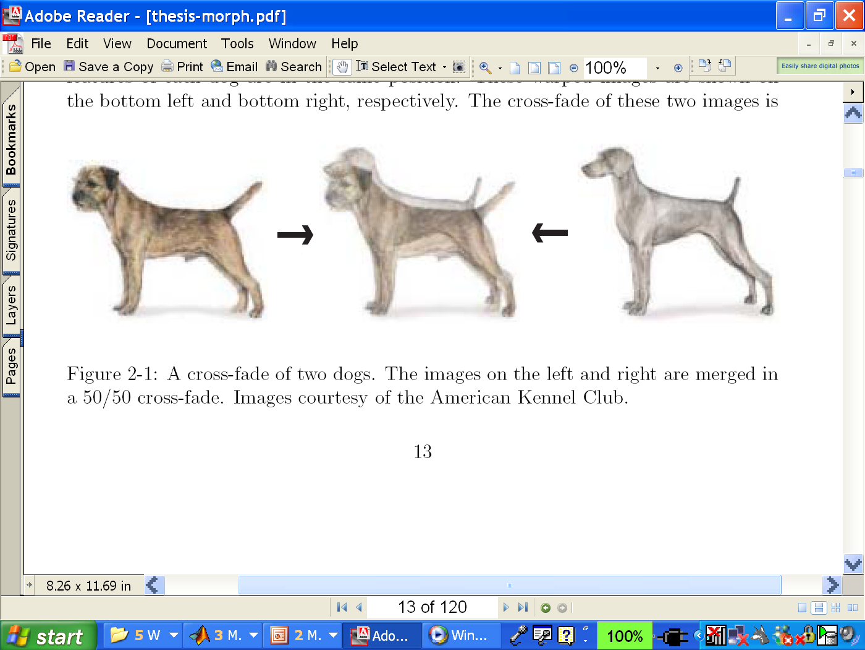
Global warp not always enough!
What to do?
Cross-dissolve doesn’t work
Global alignment doesn’t work
Cannot be done with a global transformation (e.g. affine)
Any ideas?
Feature matching!
Nose to nose, tail to tail, etc.
This is a local (non-parametric) warp

Slide 52
Local (non-parametric) Image Warping
Need to specify a more detailed warp function
Global warps were functions of a few (2,4,8) parameters
Non-parametric warps u(x,y) and v(x,y) can be defined independently for every single location x,y!
Once we know vector field u,v we can easily warp each pixel (use backward warping with interpolation)

Slide 53
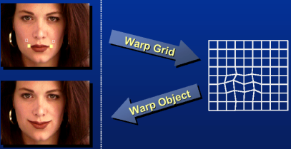
Warp specification -- dense
Define vector field to specify a dense warp

Slide 54
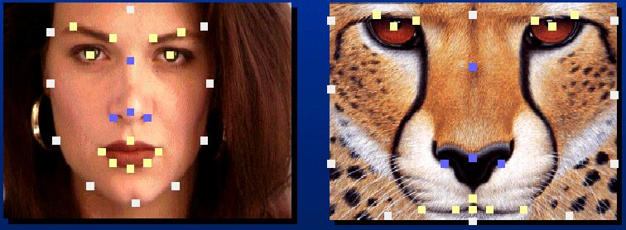
Warp specification - sparse
How can we specify a sparse warp?
How do we go from feature points to pixels?

Slide 55
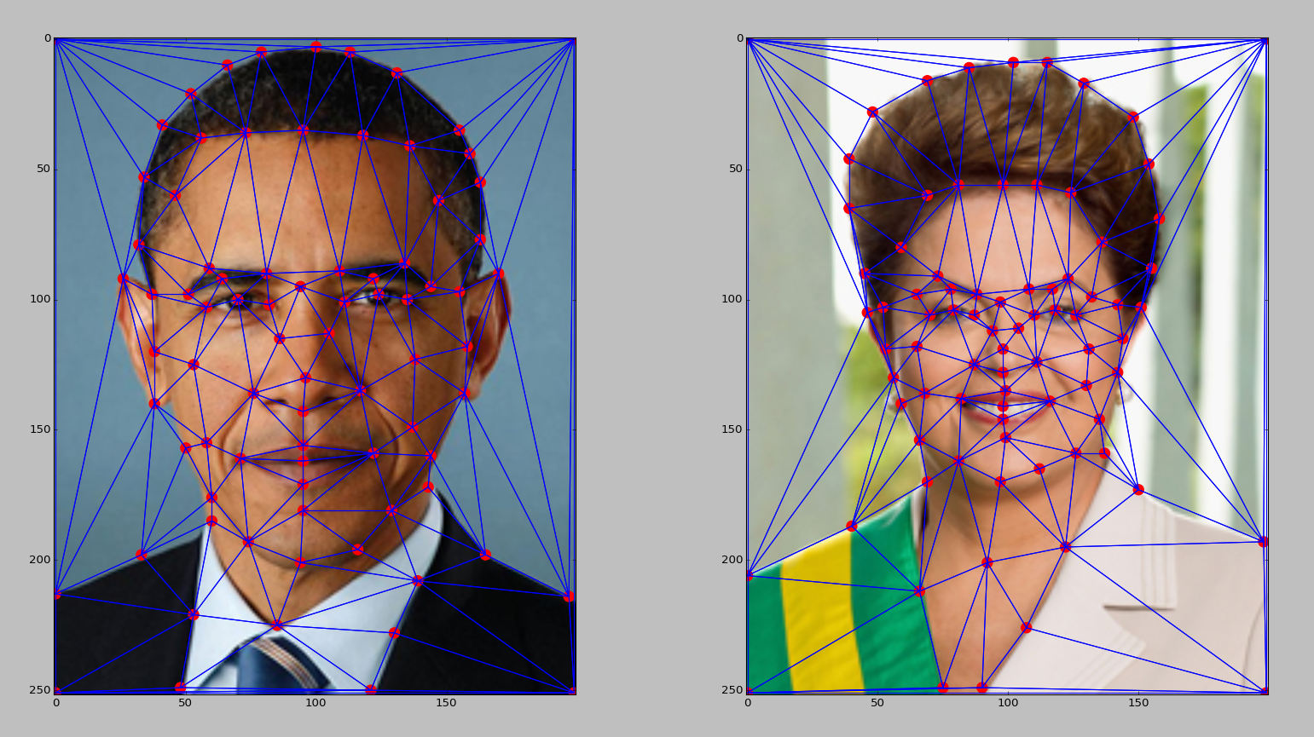
Triangular Mesh
Input correspondences at key feature points
Define a triangular mesh over the points
Same mesh in both images!
Now we have triangle-to-triangle correspondences
Warp each triangle separately from source to destination
How do we warp a triangle?

Slide 56

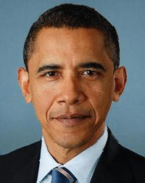
(c) Ian Albuquerque Raymundo da Silva

Slide 57
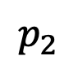
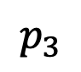
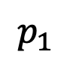
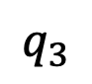
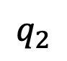
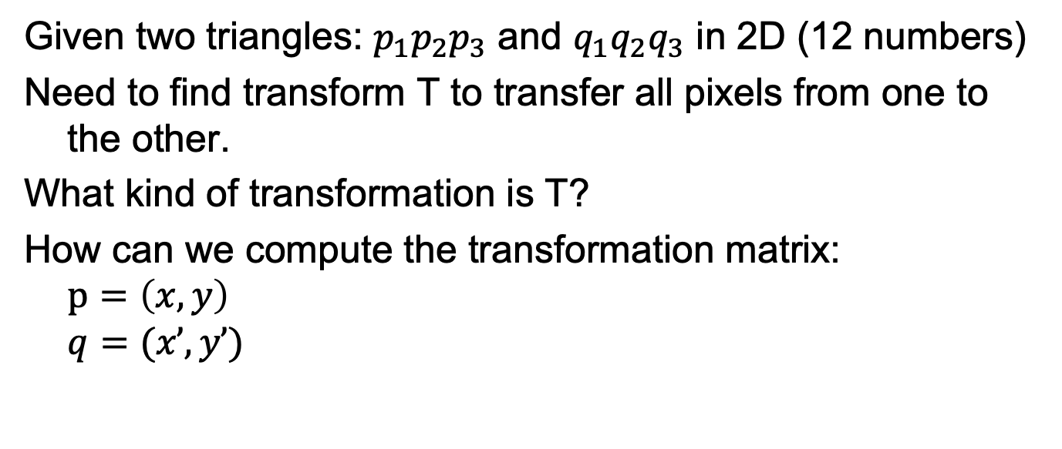
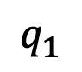
Warping triangles
$$p_{3}$$
$$q_{3}$$
?
T(x,y)
$$q_{2}$$
$$p_{1}$$
$$p_{2}$$
$$q_{1}$$
Source
Destination
Given two triangles: $p_{1}p_{2}p_{3}$ and $q_{1}q_{2}q_{3}$ in 2D (12 numbers)
Need to find transform T to transfer all pixels from one to the other.
What kind of transformation is T?
How can we compute the transformation matrix:
$$p=\left(x, y\right)$$
$$q=(x’, y’)$$
Notes:
Solve it using linear equation system.
Or form it as a least square problem.
$argmin_{T} {\left|\left|T\left(p_{i}\right)−q_{i}\right|\right|}^{2}$ for 3 points in each triangle

Slide 58
Triangulations
A triangulation of set of points in the plane is a partition of the convex hull to triangles whose vertices are the points, and do not contain other points.
There are an exponential number of triangulations of a point set.
Notes:
The Delaunay triangulation is the “best”
Maximizes smallest angles

Slide 59
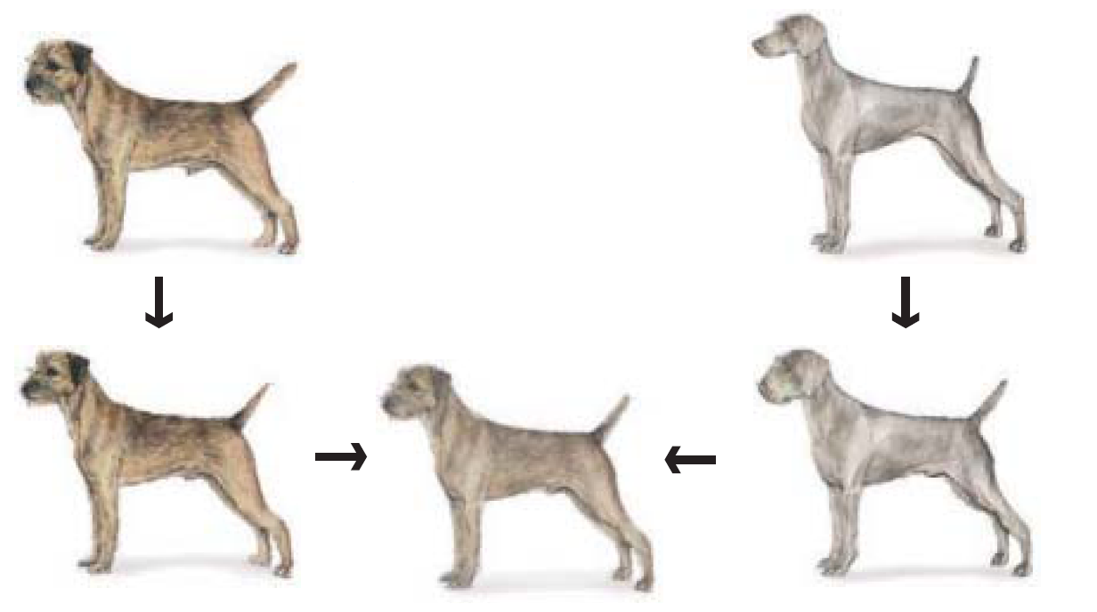
Full Morphing Procedure
Morphing procedure:
for every t,
Find the average shape (the “mean dog”☺)
local warping
Find the average color
Cross-dissolve the warped images

Slide 60
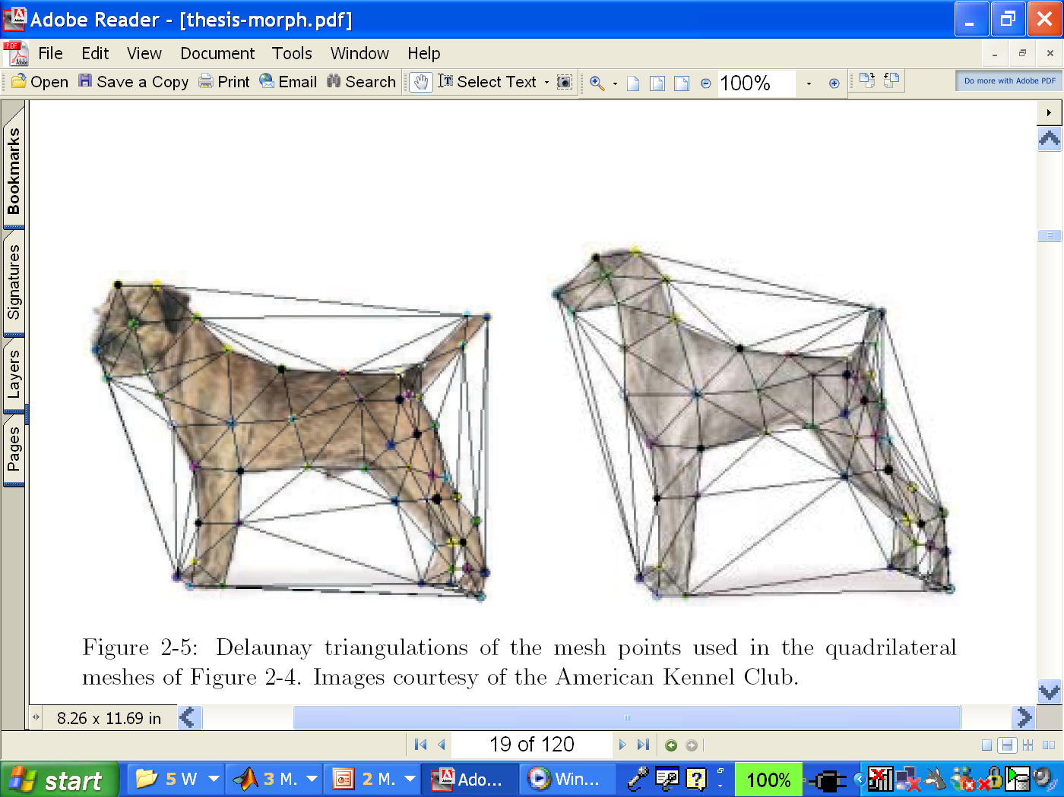
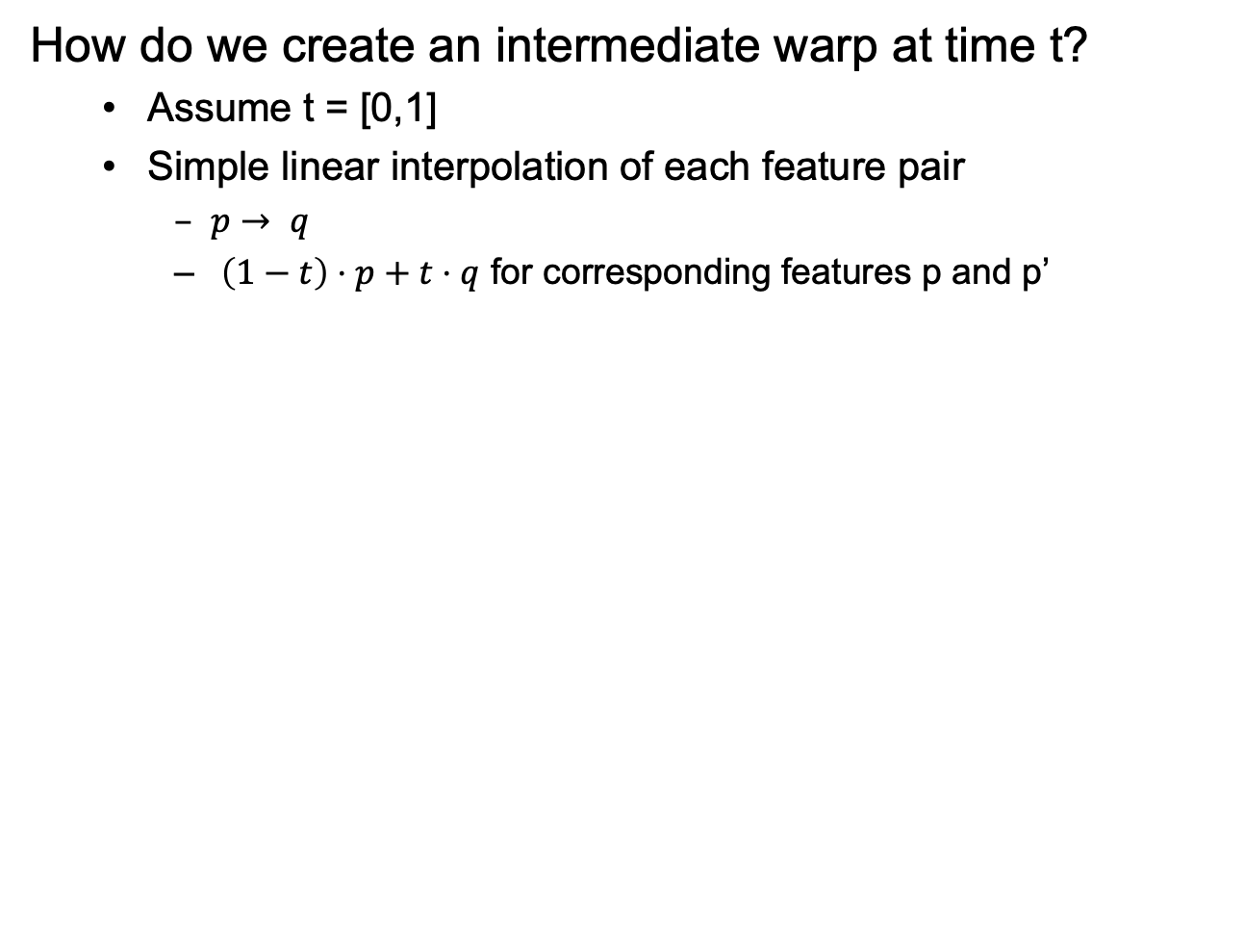
1. Create Average Shape
How do we create an intermediate warp at time t?
Assume t = [0,1]
Simple linear interpolation of each feature pair
$p→ q$
$\left(1−t\right)⋅p+t⋅q$ for corresponding features p and p’

Slide 61
2. Create Average Color
Interpolate whole images:
Image_{halfway} = (1-t)*Image + t*image’
cross-dissolve!

Slide 62
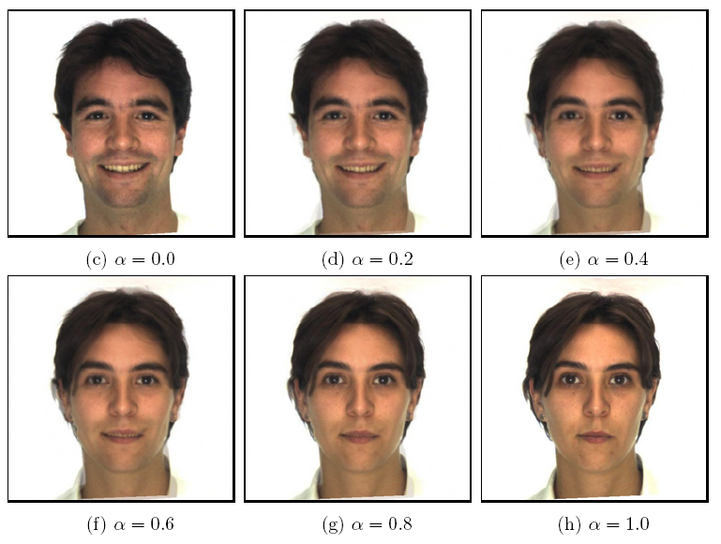
Morphing & matting
Extract foreground first to avoid artifacts in the background
Slide by Durand and Freeman

Slide 63

Amuse-bouche
By Philip Scott Johnson
Music: Bach's Sarabande from Suite for Solo Cello No. 1 in G Major, BWV 1007 performed by Yo-Yo Ma

Slide 64
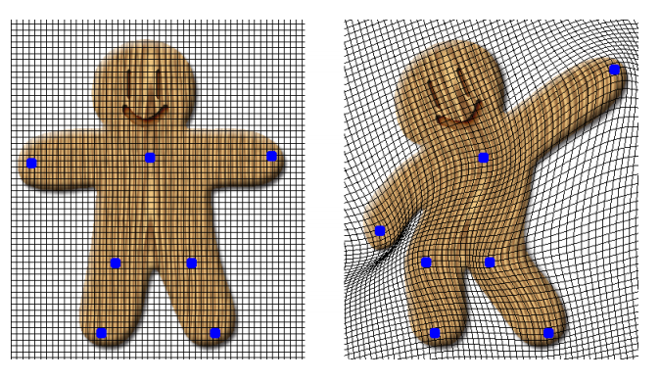
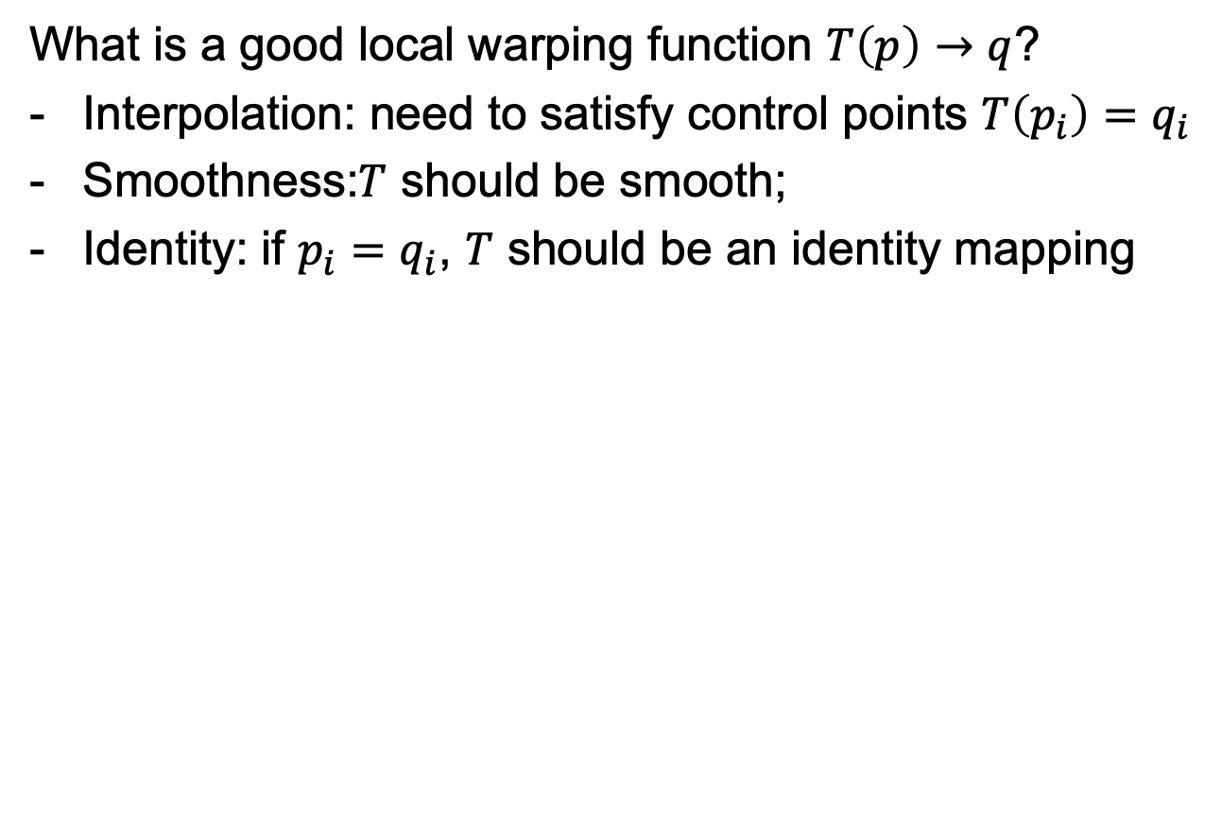
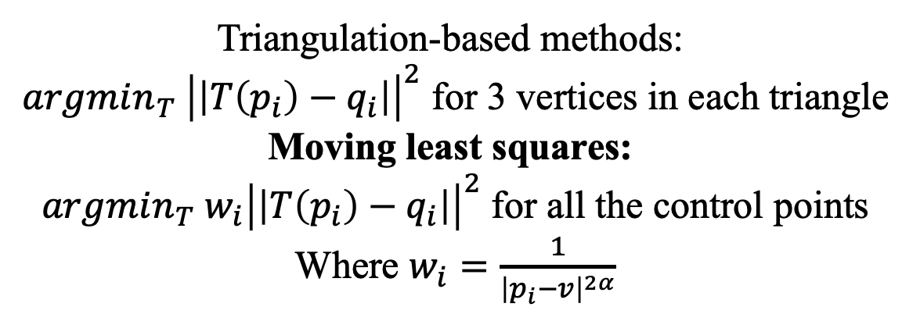
Moving Least Square
What is a good local warping function $T\left(p\right)→q$?
Interpolation: need to satisfy control points $T\left(p_{i}\right)=q_{i}$
Smoothness:$T$ should be smooth;
Identity: if $p_{i}=q_{i}$, $T$ should be an identity mapping
Triangulation-based methods:
$argmin_{T} {\left|\left|T\left(p_{i}\right)−q_{i}\right|\right|}^{2}$ for 3 vertices in each triangle
Moving least squares:
$argmin_{T} w_{i}{\left|\left|T\left(p_{i}\right)−q_{i}\right|\right|}^{2}$ for all the control points
Where $w_{i}=\frac{1}{{\left|p_{i}−v\right|}^{2α}}$
Image Deformation Using Moving Least Squares. Schaefer et al. SIGGRAPH 2006
Notes:
Trigulation requires lots of points

Slide 65
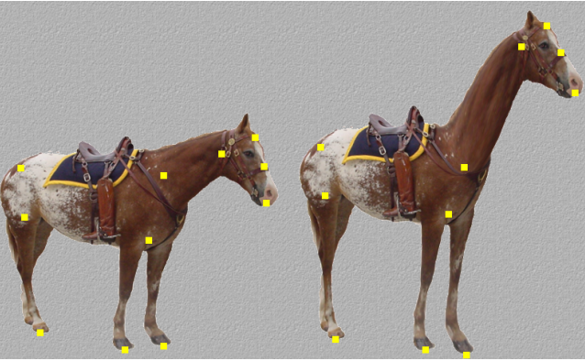
Moving Least Square
Notes:
Trigulation requires lots of points

Slide 66
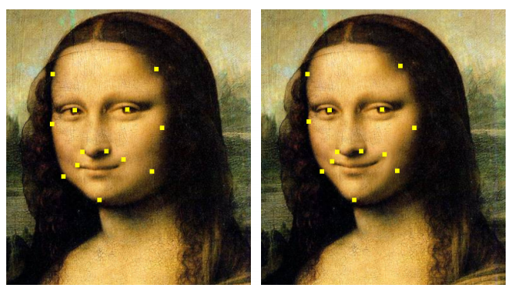
Moving Least Square
Notes:
Trigulation requires lots of points

Slide 67

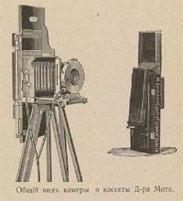
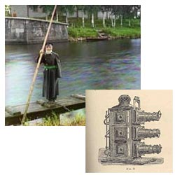
Programming Project #1
Prokudin-Gorskii’s Color Photography (1907)
Credit: Berkeley CS194-26

Slide 68
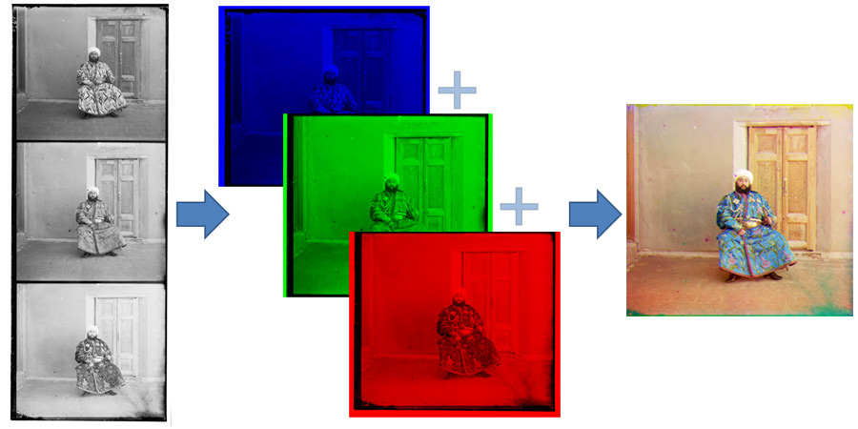
Programming Project #1
Credit: Berkeley CS194-26

Slide 69


Programming Project #1
How to compare R,G,B channels?
No right answer
Sum of Squared Differences (SSD):
Normalized Correlation (NCC):
Credit: Berkeley CS194-26

Slide 70


Student Presentation
Data-Driven Graphics (2000-2010)
Graphcut Texture, SIGGRAPH 2003.
Interactive Digital Photomontage, SIGGRAPH 2004.
GrabCut, SIGGRAPH 2004.
Hybrid Images, SIGGRAPH 2006.
Photo Clip Art, SIGGARPH 2007.
Image Deformation Using Moving Least Squares. SIGGRAPH 2006.
Seam Carving for Content-Aware Image Resizing, SIGGRAPH 2007.
Sketch2Photo, SIGGRAPH Asia 2009.
Coordinates for Instant Image Cloning, SIGGRAPH 2009
…

Slide 71


Thank You!
© Rachel Albert
16-726, Spring 2021
https://learning-image-synthesis.github.io/

